Slide 1
PICTURES
of GRACE
Grace to Build Faith - Gideon

Slide 2
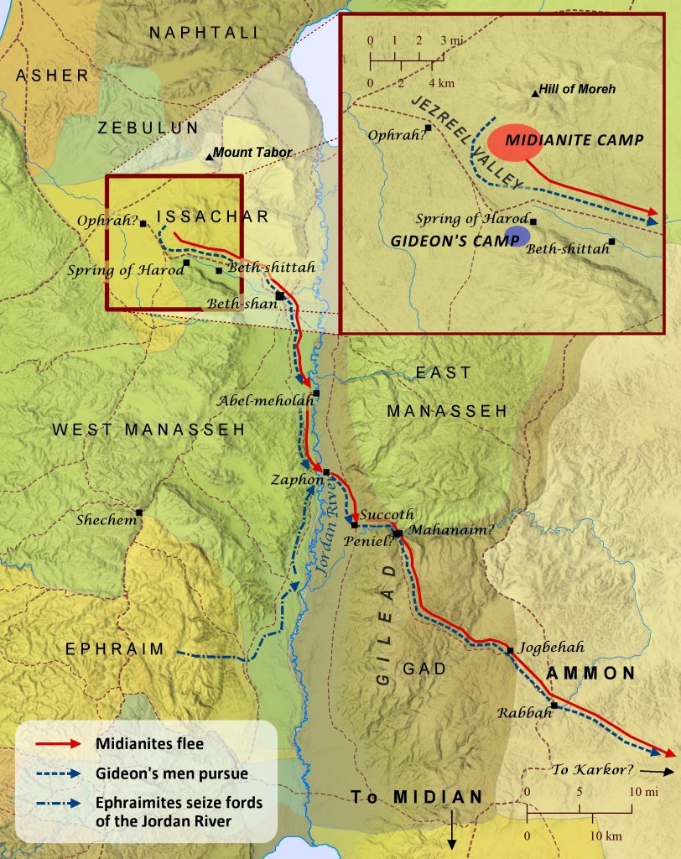

Slide 3
GRACE FOR
A HUMBLE MAN

Slide 4
Gideon Was
A Selfless Man

Slide 5
Gideon Was
A Submissive Man

Slide 6
GRACE FOR
AN OBEDIENT MAN

Slide 7
A Developing Faith

Slide 8
A Display of Faith

Slide 11
GRACE FOR
A FAITHFUL MAN

Slide 12
A Clear Plan

Slide 13
A Complete Victory

Slide 14
PICTURES
of GRACE

