Slide 1
PICTURES
of GRACE
Joshua: Grace to Go On

Slide 2
REMEMBER
GOD’S CALLING

Slide 3
A Difficult Time

Slide 4
A Dedicated Man

Slide 5
A Directed Purpose

Slide 6
REMEMBER
GOD’S PROVISION

Slide 7
Provision
of the Land

Slide 8
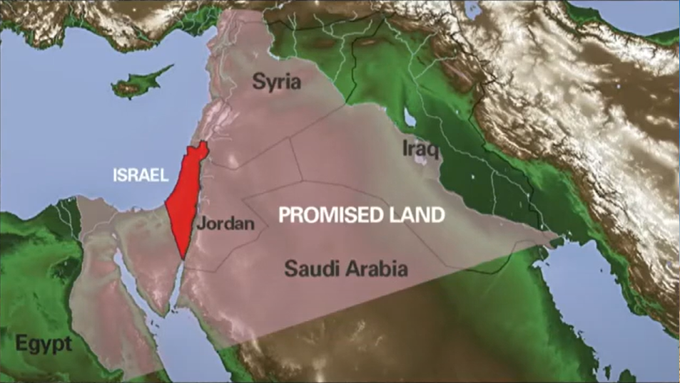

Slide 9
Provision
of Protection

Slide 10
Provision
of God’s Presence

Slide 11
REMEMBER GOD’S REQUIREMENTS

Slide 12
Courageous Faith

Slide 13
Complete Obedience

Slide 14
Continual Meditation

Slide 15
PICTURES
of GRACE

