Slide 1
R E V I V E
R e v i v a l o f O u r F i r s t L o v e

Slide 2
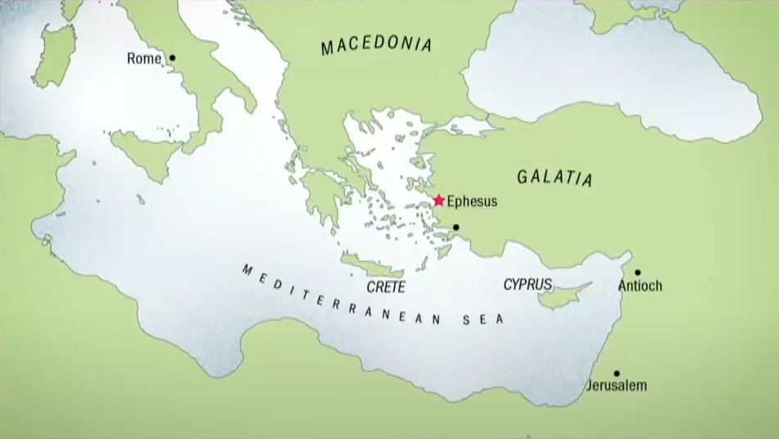

Slide 3
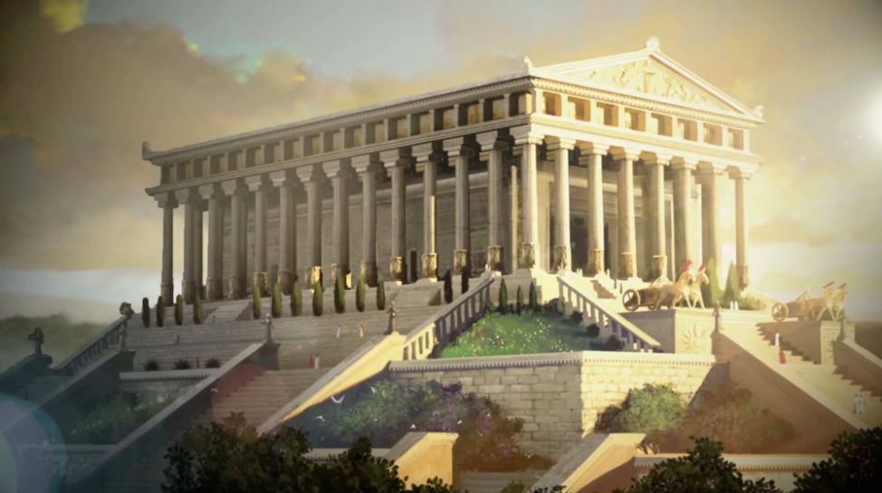
THE TEMPLE OF ARTEMIS
(also known as Diana)

Slide 4
THE LORD’S APPROVAL

Slide 5
A Caring Church
Revival of Our First Love

Slide 6
A Contending Church
Revival of Our First Love

Slide 7
A Consistent Church
Revival of Our First Love

Slide 8
THE LORD’S ACCUSATION

Slide 9
The Passion
Had Lessened
Revival of Our First Love

Slide 10
Their Witness
Had Diminished
Revival of Our First Love

Slide 11
THE LORD’S ADVICE

Slide 12
Remember
Revival of Our First Love

Slide 13
Repent
Revival of Our First Love

Slide 14
Receive
Revival of Our First Love

Slide 15
R E V I V E

