Slide 1

FREEDOM FROM
THE GOD OF SECOND CHANCE

Slide 2
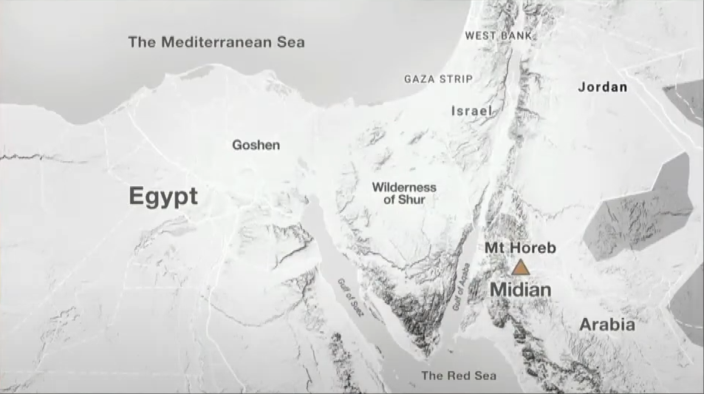


Slide 3
THE COMMUNICATION
OF GOD

Slide 4

THE COMMUNICATION OF GOD
A MANIFESTATION

Slide 5
THE COMMUNICATION OF GOD
A MESSAGE

Slide 6
THE COMPASSION
OF GOD

Slide 7
THE COMPASSION OF GOD
HE IS OMNISCIENT

Slide 8
THE COMPASSION OF GOD
HE IS OMNIPOTENT

Slide 9
THE COMMISSION
OF GOD

Slide 10
THE COMMISSION OF GOD
GOD’S PLAN

Slide 11
“God does not call the qualified; He qualifies the called.”

Slide 12
THE COMMISSION OF GOD
MOSES’ PLEA

Slide 13
THE COMMISSION OF GOD
GOD’S PROMISE

Slide 14
FREEDOM FROM

