Slide 1
TRANSFORMED
BY GRACE
Transformed Lives

Slide 2
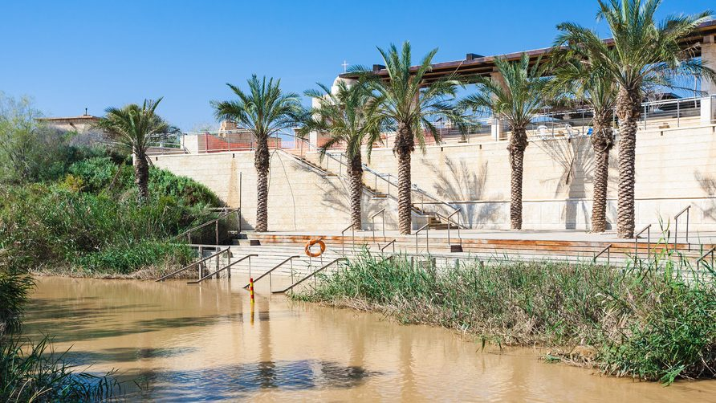
THE JORDAN RIVER AT BETHABARA

Slide 3
WHEN CHRIST
IS MAGNIFIED

Slide 4
BEHOLD THE LAMB

Slide 5
BEHOLD THE LAMB OF GOD

Slide 6
WHEN INVITATIONS
ARE GIVEN

Slide 7
COME AND SEE

Slide 8
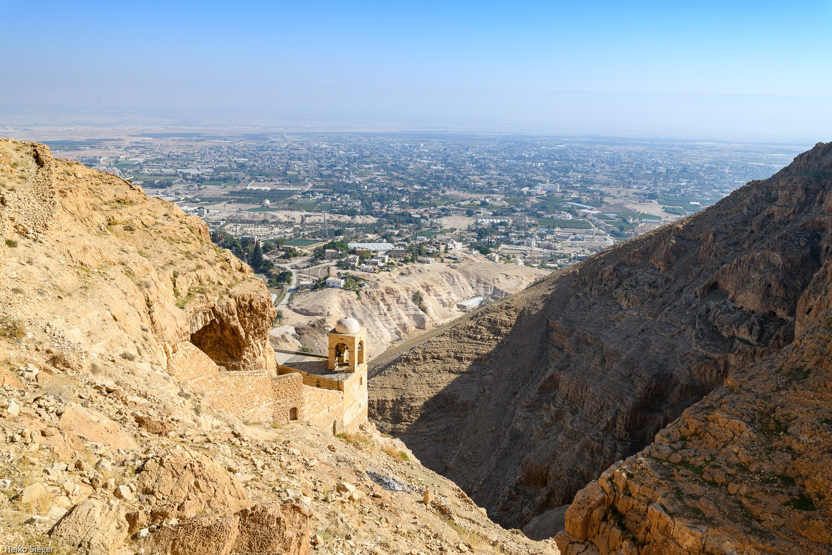
JERICHO

Slide 9
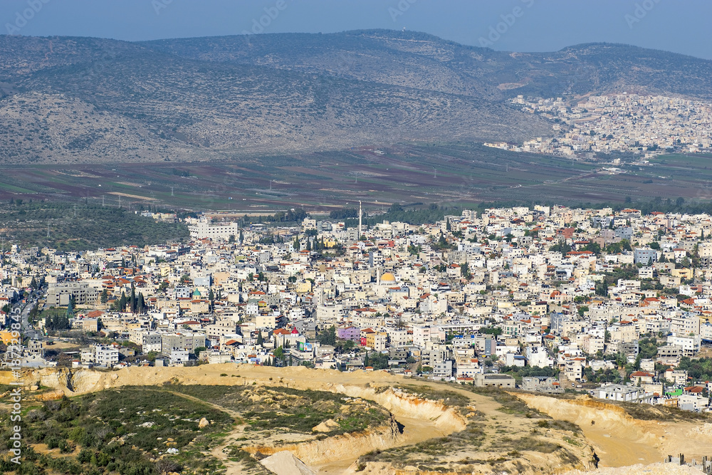
CANA

Slide 10
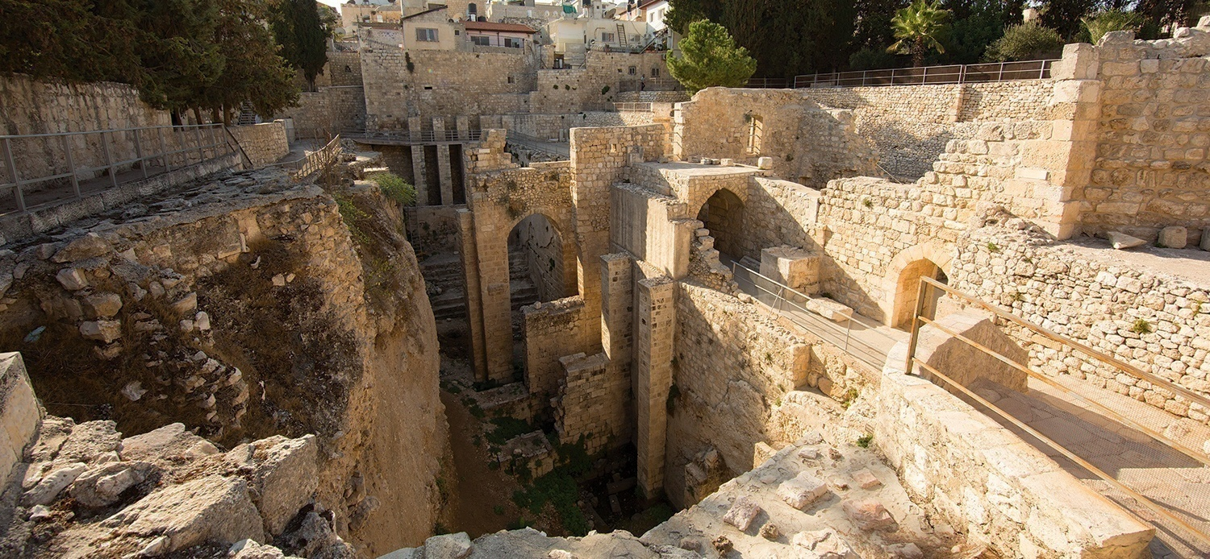
POOL OF BETHESDA

Slide 11
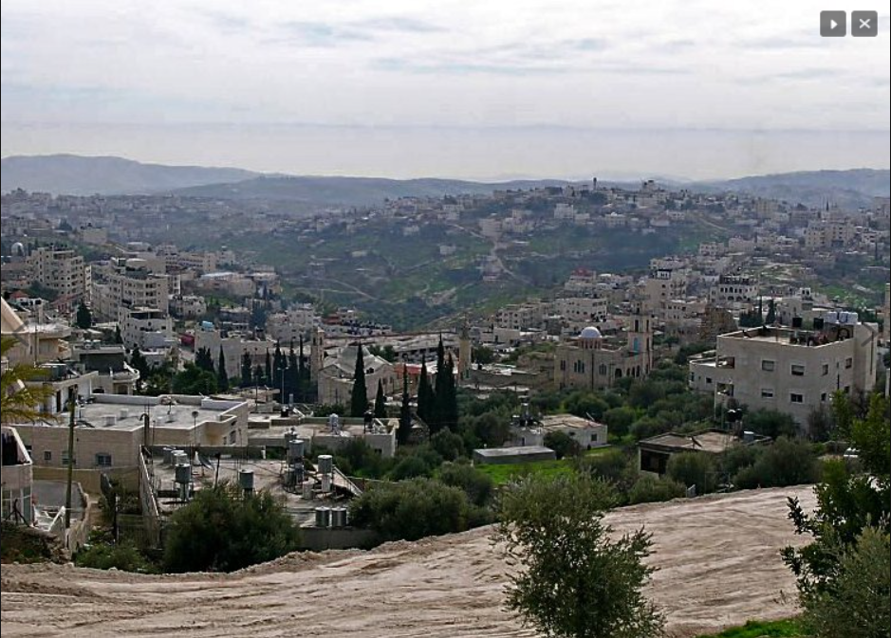
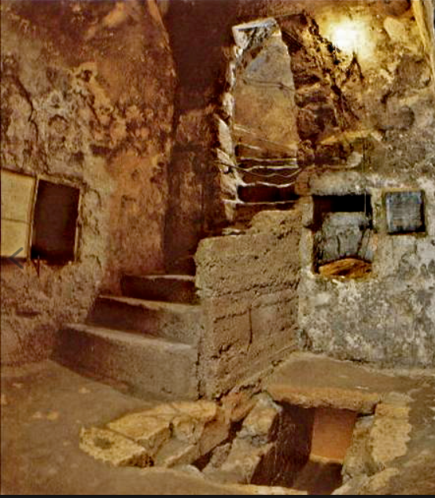
BETHANY

Slide 12
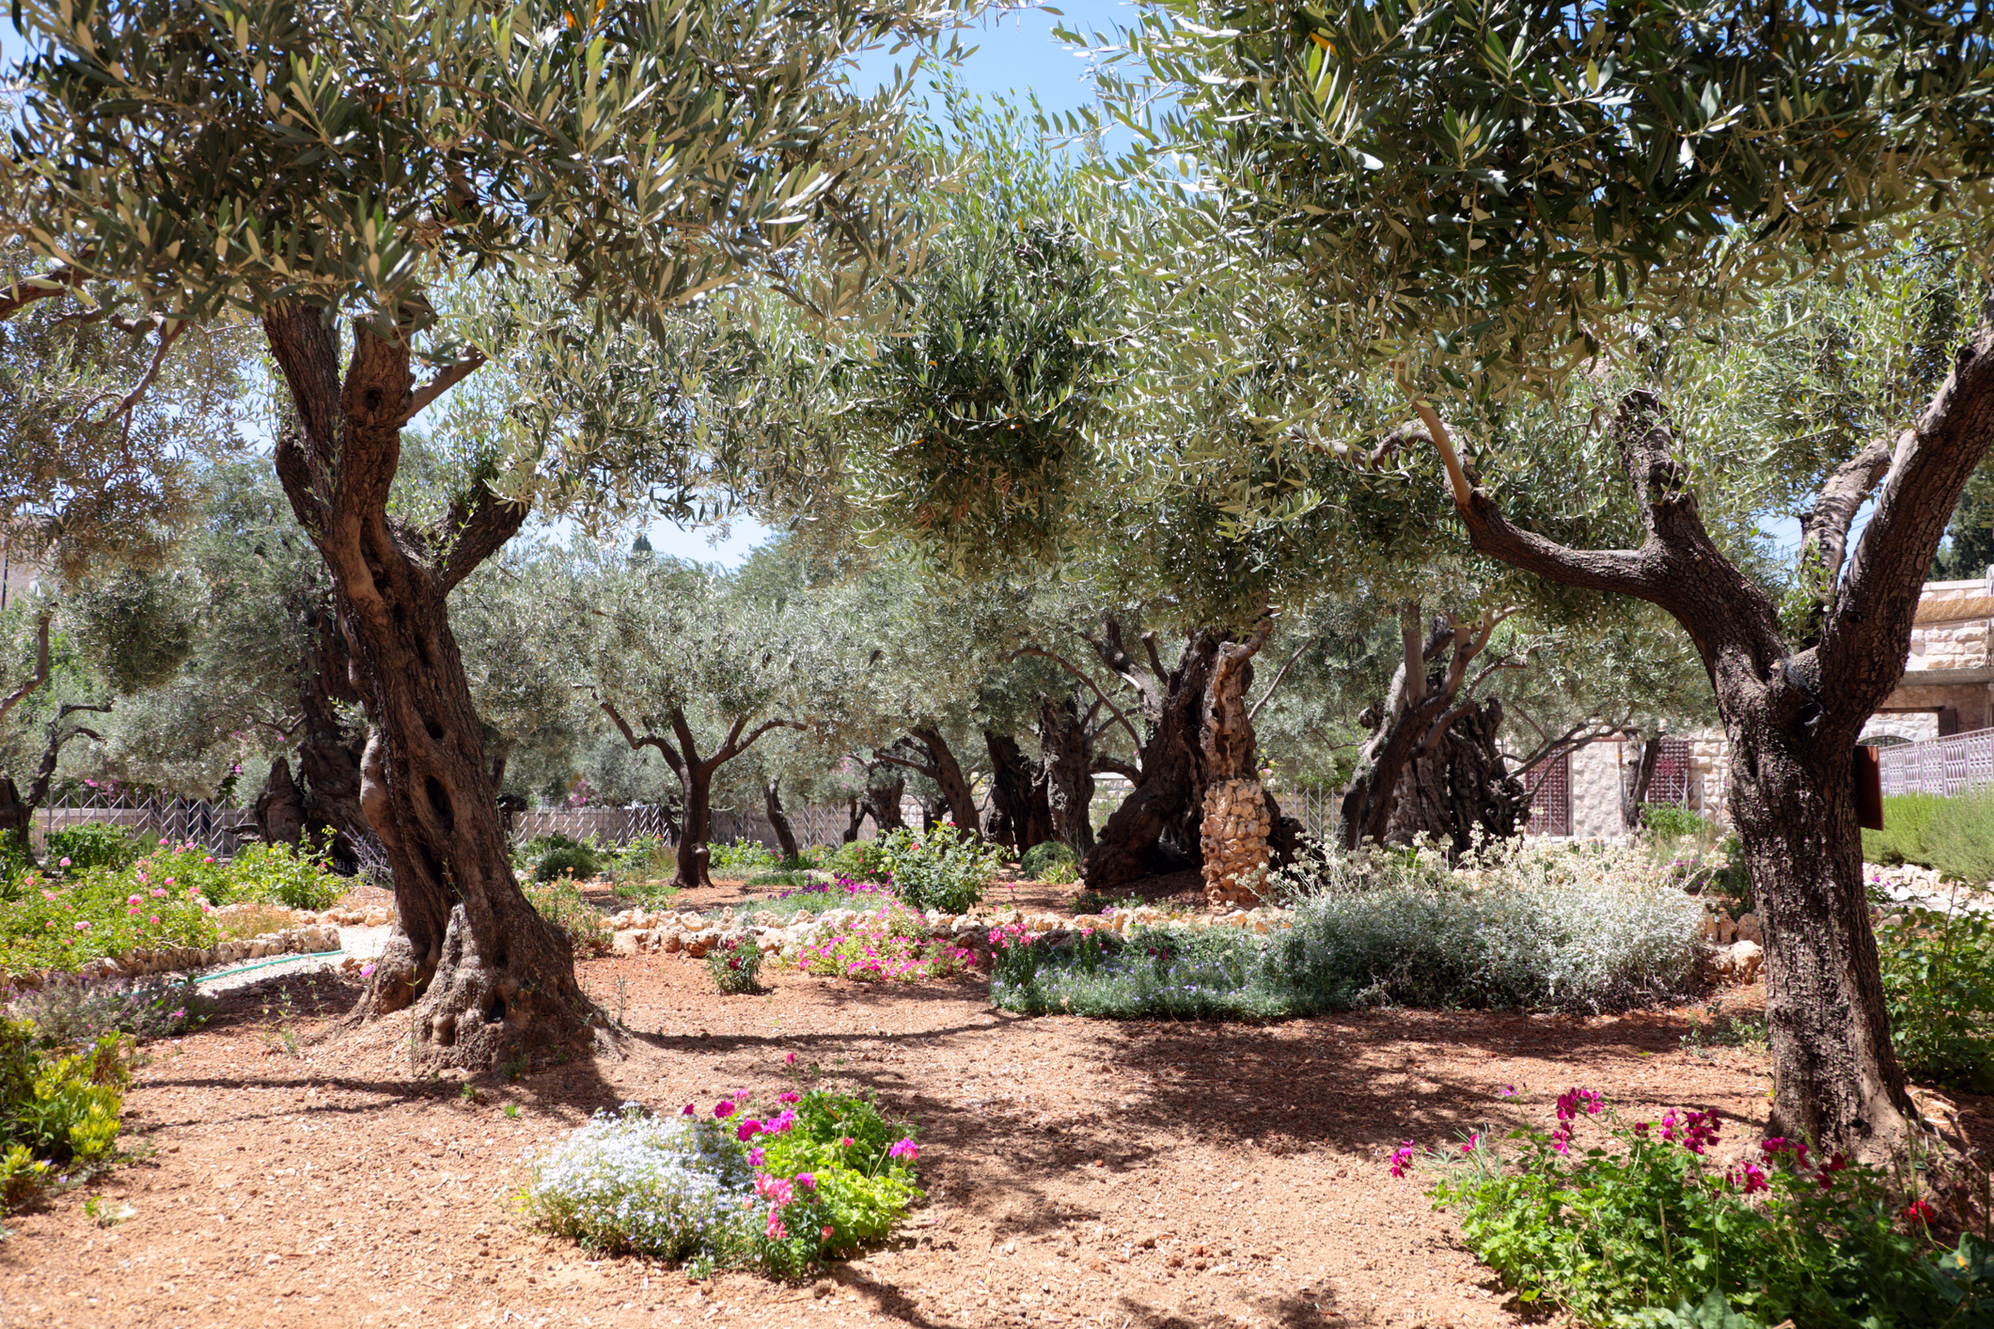
GARDEN OF GETHSEMANE

Slide 13
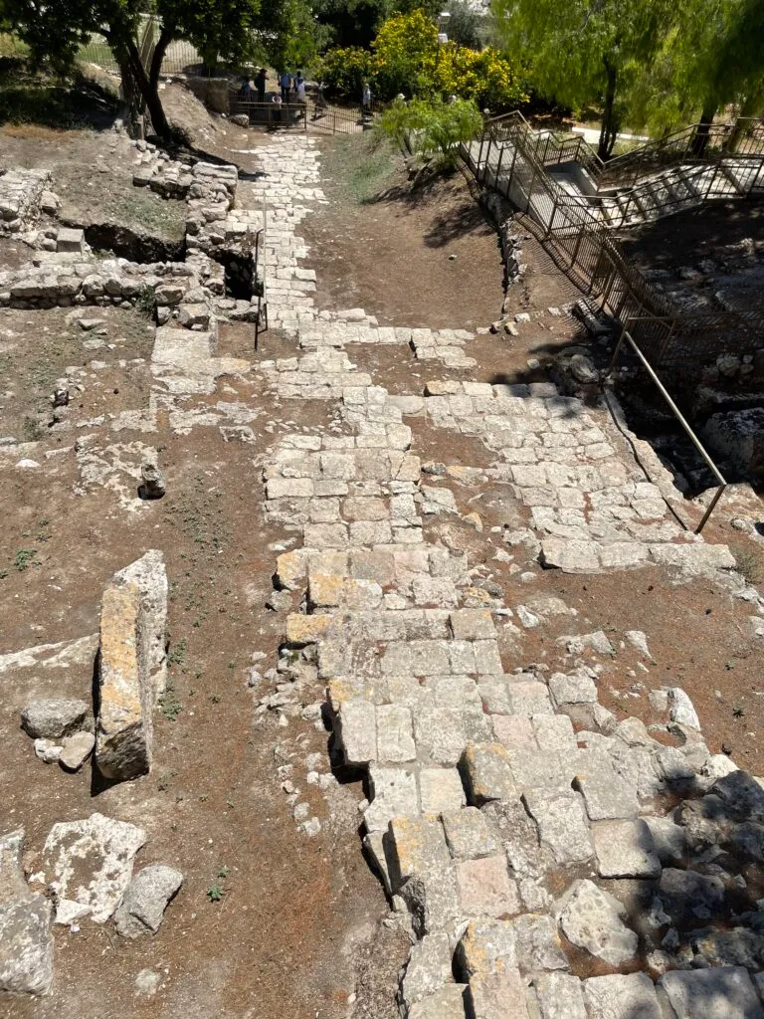
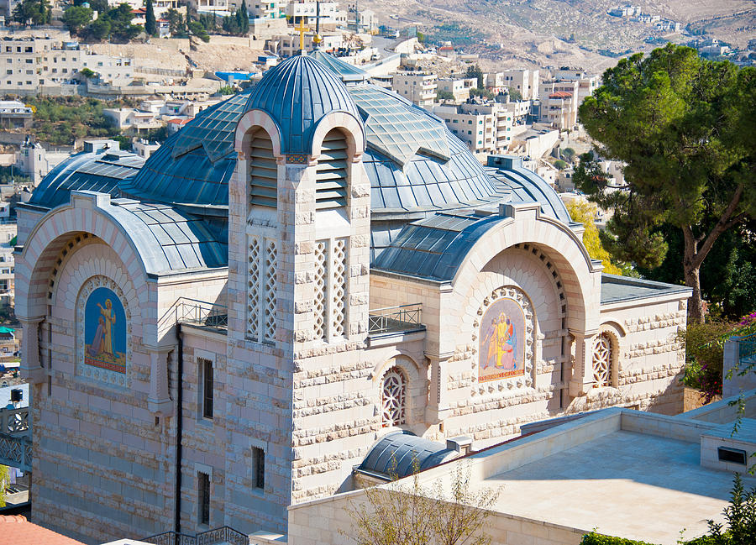
HOUSE OF CAIAPHAS

Slide 14
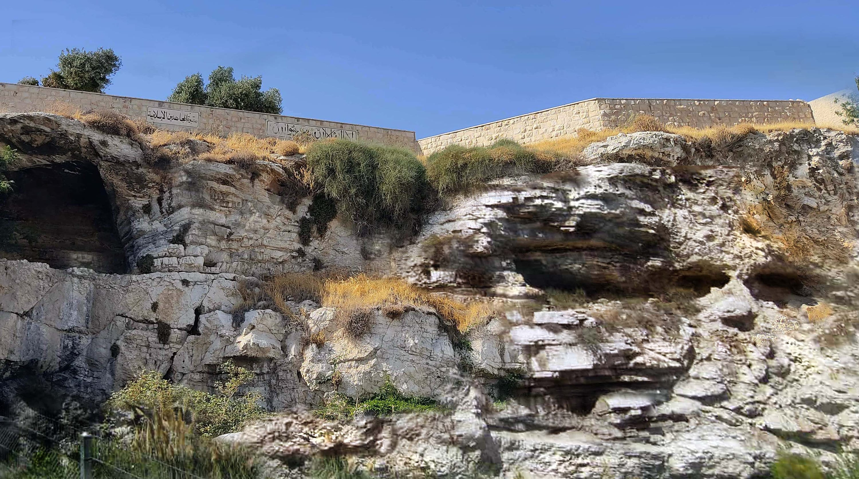
GOLGOTHA

Slide 15
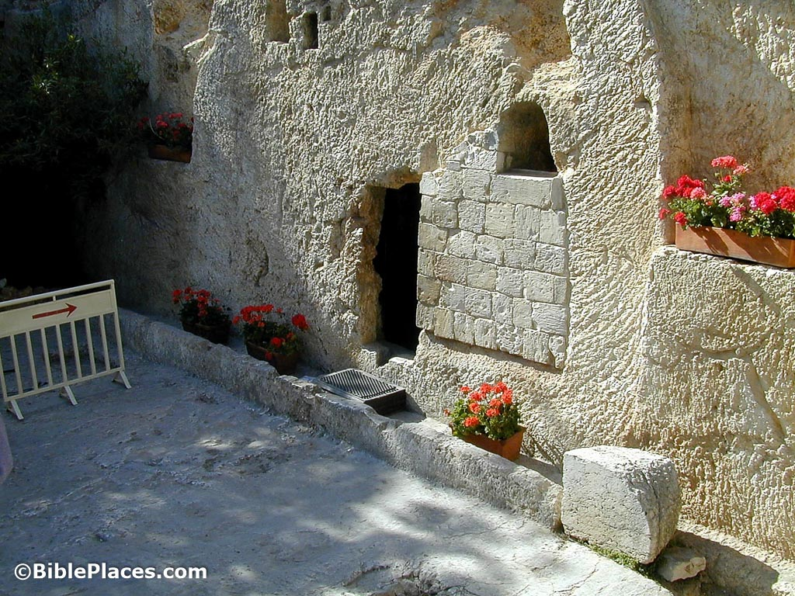
THE GARDEN TOMB

Slide 16
FOLLOW ME

Slide 17
WHEN DISCIPLES
ARE FAITHFUL

Slide 18
TRANSFORMATION
OF COMPASSION

Slide 19
TRANSFORMATION
OF PARTICIPATION

Slide 20
TRANSFORMED
BY GRACE

