Slide 1
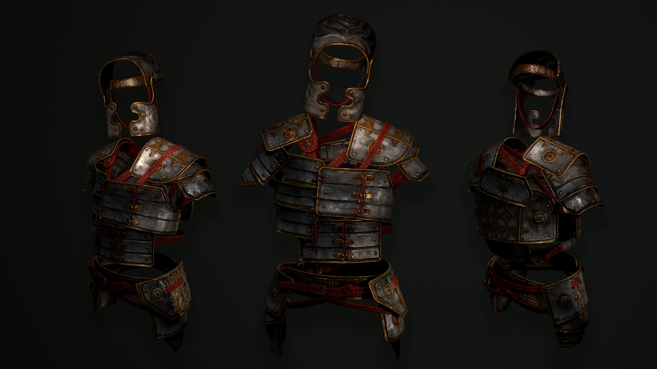
A BATTLE FOR THE
CHRISTIAN HOME
- The Lord’s Army -

Slide 2
WE ARE ALL
ENLISTED

Slide 3
WE ARE ALL ENLISTED
We Are Soldiers
In God’s Army

Slide 4
WE MUST BE
ENGAGED

Slide 5
WE MUST BE ENGAGED
Engage As A Soldier
Of Jesus Christ

Slide 6
WE MUST BE ENGAGED
Engage In Our
Christian Home

Slide 7
WE ARE
ENABLED

Slide 8
WE ARE ENABLED
We Need The Lord

Slide 9
WE ARE ENABLED
We Need The
Armour of God

Slide 10
A BATTLE FOR THE
CHRISTIAN HOME

