Slide 1
FREEDOM FROM
DELIVERED FROM EGYPTIAN BONDAGE

Slide 2
DECLARATION
OF A HOLY GOD

Slide 3
THE DECLARATION OF A HOLY GOD
THE JUDGEMENT
UPON EGYPT

Slide 4
THE DECLARATION OF A HOLY GOD
THE JOURNEY
OF THE ISRAELITES

Slide 5
DIRECTION
OF A PROVIDENTIAL GOD

Slide 6
THE DIRECTION OF A PROVIDENTIAL GOD
A UNIQUE ROUTE

Slide 7
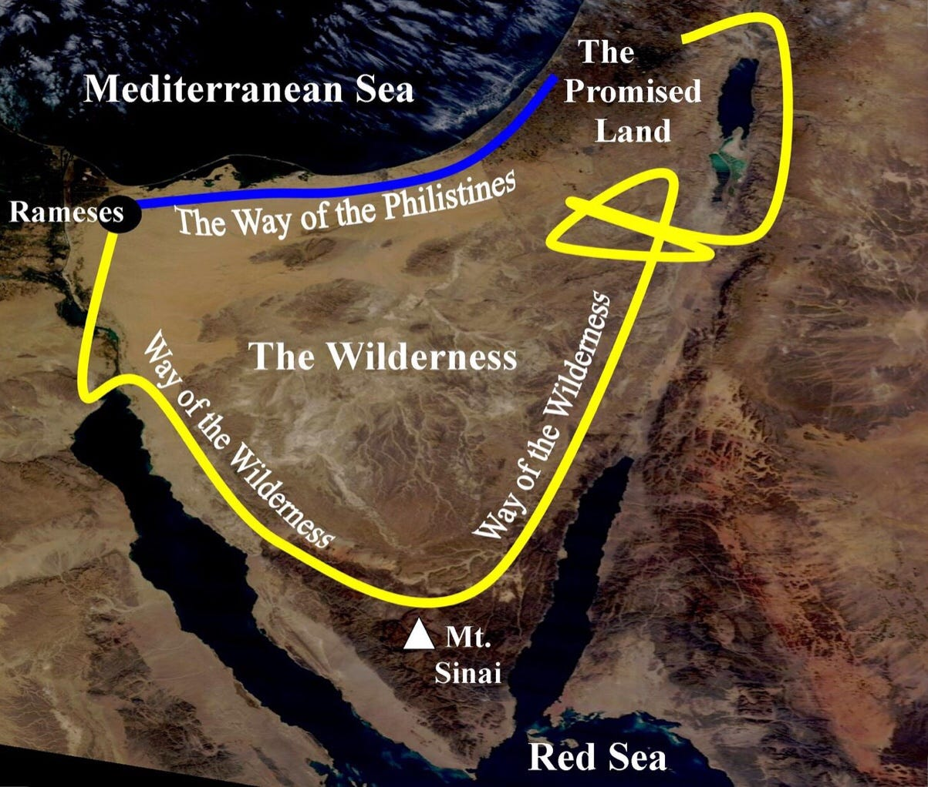

Slide 8
THE DIRECTION OF A PROVIDENTIAL GOD
A UNIQUE GUIDANCE

Slide 9
DELIVERANCE
OF A MIGHTY GOD

Slide 10
THE DELIVERANCE OF A MIGHTY GOD
A DANGEROUS POSITION

Slide 11
THE DELIVERANCE OF A MIGHTY GOD
A DOUBTING PEOPLE

Slide 12
THE DELIVERANCE OF A MIGHTY GOD
A DIVINE PROVISION

Slide 13
FREEDOM FROM

