Slide 1
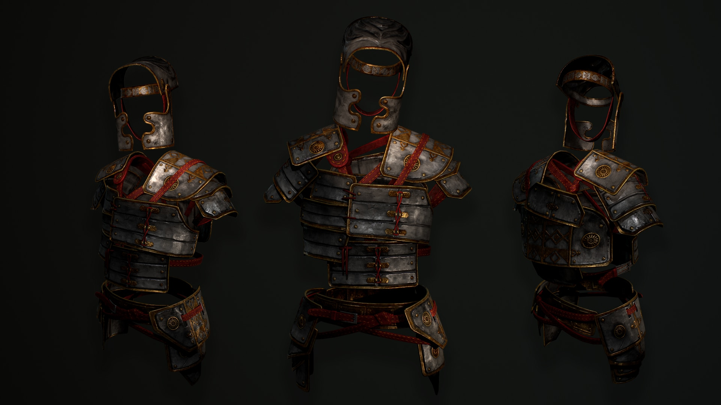
A BATTLE FOR THE
CHRISTIAN HOME
- Gospel Shoes -

Slide 2
THE PURPOSE
OF THE SHOES

Slide 3
THE PURPOSE OF THE SHOES
They Provided A Foundation

Slide 4
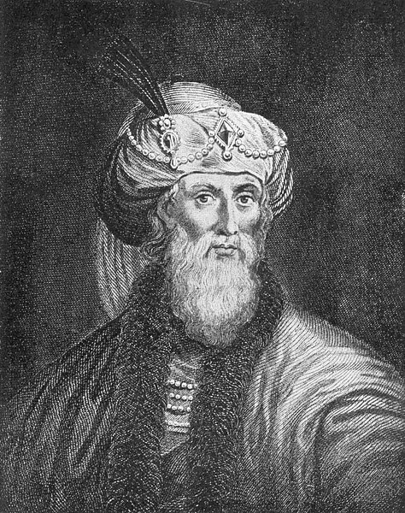
“The Roman Centurion shoes are thickly studded with sharp nails on the bottom, so as to ensure a good grip for marching and in battle.”
Josephus Flavius
37-100 AD

Slide 5
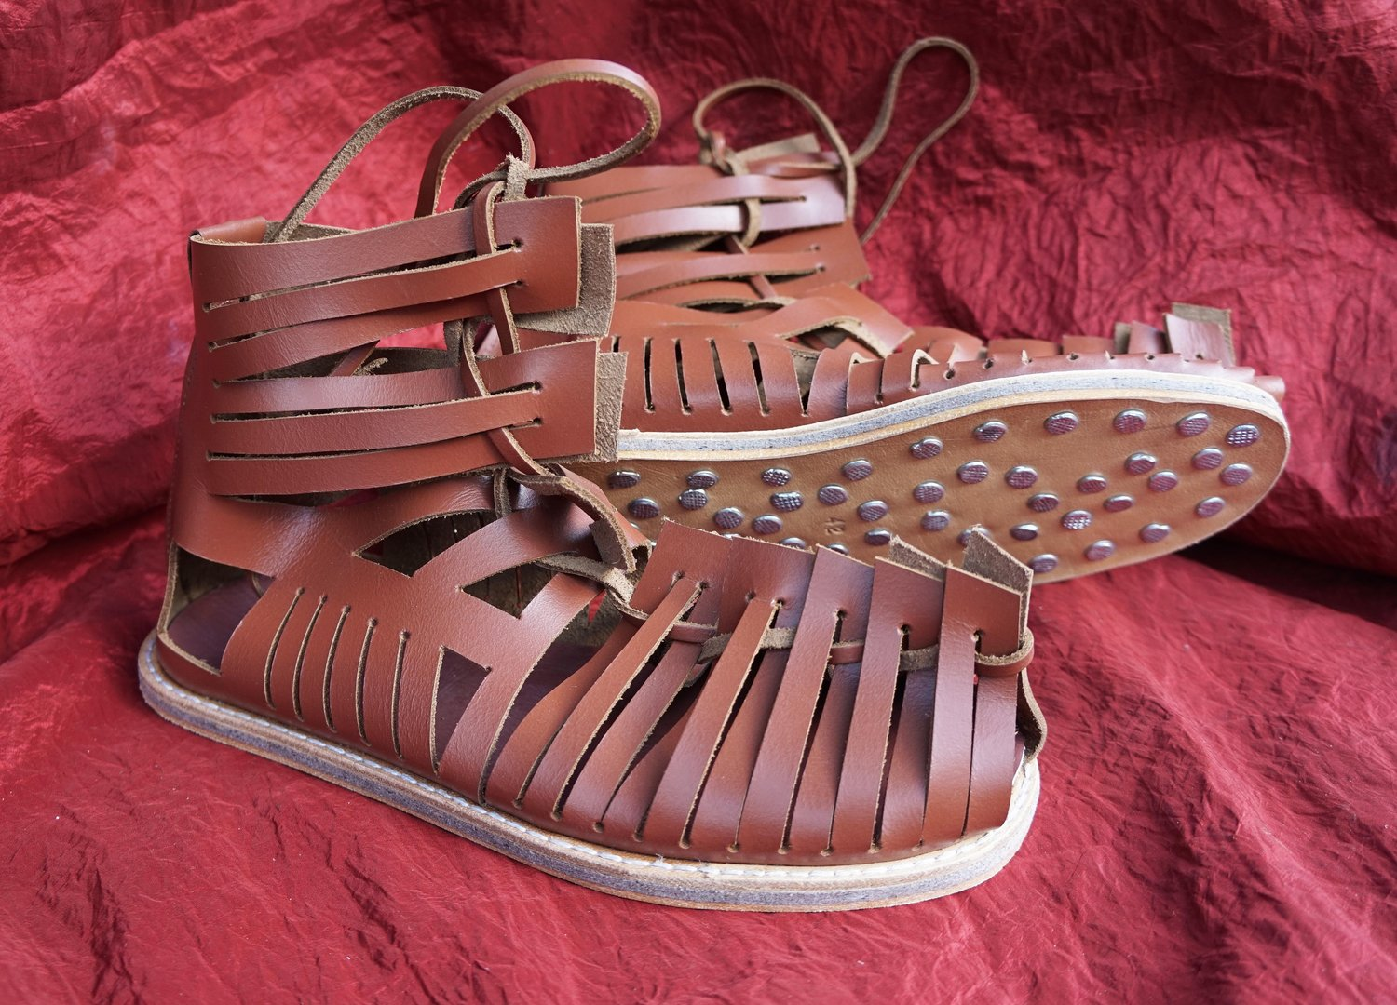
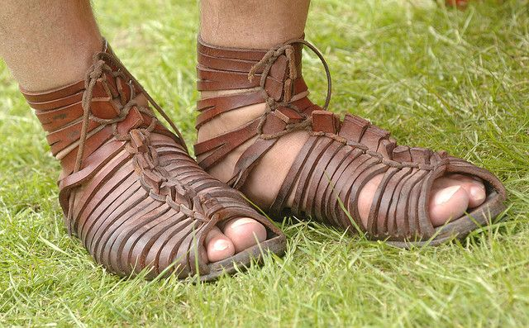
The Roman Soldier’s Footwear - Caligae

Slide 6
THE PURPOSE OF THE SHOES
They Provided Protection

Slide 7
THE PREPARTION
OF THE SHOES

Slide 8
THE PREPARATION OF THE SHOES
Know The Gospel

Slide 9
THE POWER
OF THE SHOES

Slide 10
THE POWER OF THE SHOES
The Gospel Brings Peace

Slide 11
A BATTLE FOR THE
CHRISTIAN HOME

