Slide 1
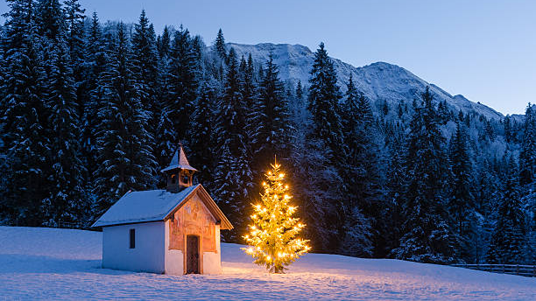
And the angel said unto her, Fear not, Mary: for thou hast found favour with God. And, behold, thou shalt conceive in thy womb, and bring forth a son, and shalt call his name JESUS.
Luke 1:30-31

Slide 2
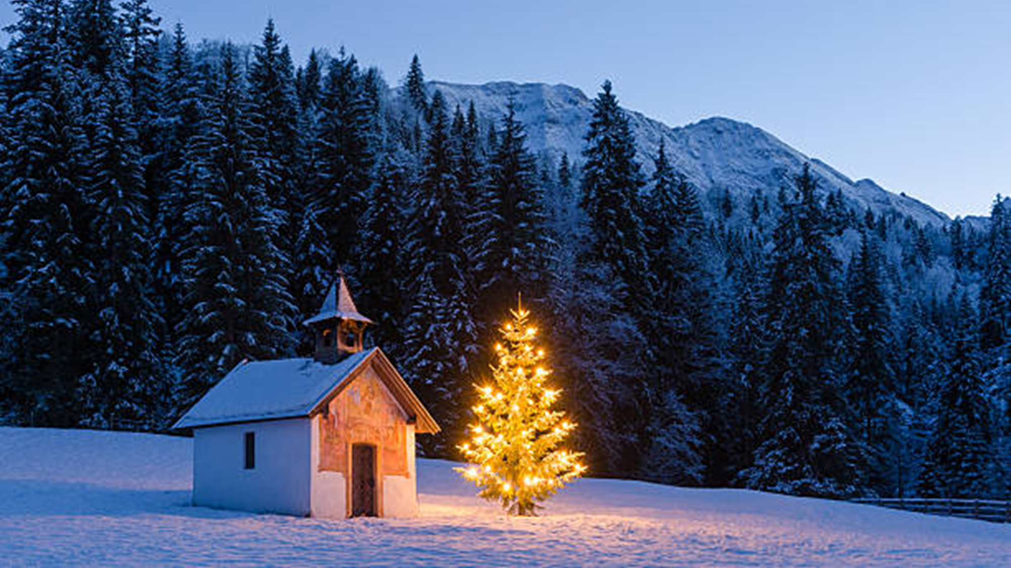
Welcome
to
Underwood Baptist Church
We are glad you are here with us.

Slide 3
#145
O Come All Ye Faithful

Slide 4
3rd Verse
Yea, Lord, we greet Thee, born this happy morning,
Jesus, to Thee be all glory giv’n:
Word of the Father, now in flesh appearing!
O come, let us adore Him,
O come, let us adore Him,
O come, let us adore Him, Christ the Lord!

Slide 5
#66
To God Be the Glory

Slide 6
1st Verse
To God be the glory, great things he has done! So loved he the world that he gave us his Son,
who yielded his life an atonement for sin, and opened the life gate that we may go in.
Praise the Lord, praise the Lord, let the earth hear his voice! Praise the Lord, praise the Lord, let the people rejoice!
O come to the Father thro' Jesus the Son, and give him the glory, great things he has done!

Slide 7
2nd Verse
O perfect redemption, the purchase of blood! To ev'ry believer the promise of God;
the vilest offender who truly believes, that moment from Jesus a pardon receives.
Praise the Lord, praise the Lord, let the earth hear his voice! Praise the Lord, praise the Lord, let the people rejoice!
O come to the Father thro' Jesus the Son, and give him the glory, great things he has done!

Slide 8
3rd Verse
Great things he has taught us, great things he has done, and great our rejoicing through Jesus the Son;
but purer and higher and greater will be our wonder, our transport, when Jesus we see.
Praise the Lord, praise the Lord, let the earth hear his voice! Praise the Lord, praise the Lord, let the people rejoice!
O come to the Father thro' Jesus the Son, and give him the glory, great things he has done!

Slide 9
#154
What Can I Give Him?

Slide 10
Verse
What can I give Him, poor as I am?
If I were a shepherd I would bring a lamb;
If I were a wiseman I would do my part;
Yet what can I give Him?
Give Him my heart.

Slide 11
Announcements
^{December 24th}
^{Candlelight Service 5PM}
^{January 3rd}
^{Ladies Meeting 6PM}
^{January 4th}
^{Visitation Day 9AM}
^{January 5th}
^{Vision Sunday}
^{January 18th}
^{YAH/MAA Game Day}
^{January 26th}
^{UBC 28th Anniversary}

Slide 12
#350
‘Tis So Sweet to Trust in Jesus

Slide 13
1st Verse
'Tis so sweet to trust in Jesus,
Just to take Him at His word,
Just to rest upon His promise,
Just to know: "Thus saith the Lord.“
Jesus, Jesus, how I trust Him!
How I've proved Him o'er and o’er!
Jesus, Jesus, precious Jesus!
O for grace to trust Him more!

Slide 15
4th Verse
I'm so glad I learned to trust Him,
Precious Jesus, Savior, Friend;
And I know that He is with me,
Will be with me to the end.
Jesus, Jesus, how I trust Him!
How I've proved Him o'er and o’er!
Jesus, Jesus, precious Jesus!
O for grace to trust Him more!

Slide 17
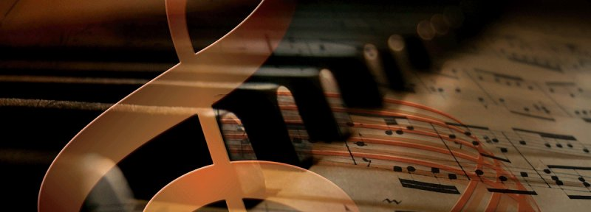
Special Singing

Slide 18
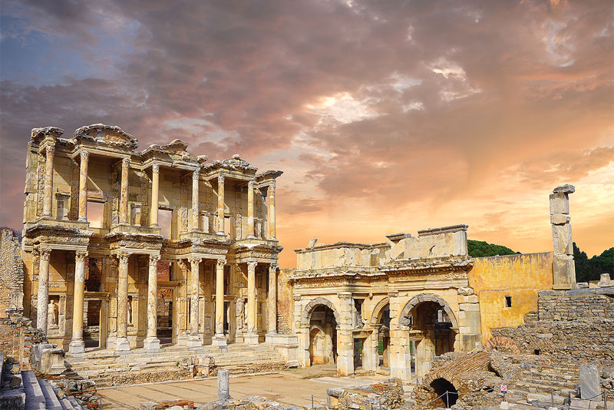
THE
ACTS
OF THE APOSTLES
- Declaring Truth In A Pagan Culture -
Sermon Series: The Church in Action

Slide 19
WHAT THE
APOSTLE PAUL SAW

Slide 20
His Heart Was Stirred

Slide 21
His Voice Was Heard

Slide 22
WHERE THE
APOSTLE PAUL WENT

Slide 23
The Location
Of Paul’s Ministry

Slide 24
The Proclamation
Of Paul’s Ministry

Slide 25
WHAT THE
APOSTLE PAUL SAID

Slide 26
The Presence
Of The True God

Slide 27
The Power
Of The True God

Slide 28
The Provision
Of The True God

Slide 29
THE
ACTS
OF THE APOSTLES
Sermon Series: The Church in Action

Slide 30
#349
Trust and Obey

Slide 31
1st Verse
When we walk with the Lord in the light of His Word, What a glory He sheds on our way! While we do His good will, He abides with us still, And with all who will trust and obey.
Trust and obey, For there’s no other way To be happy in Jesus, But to trust and obey.

Slide 32
2nd Verse
Not a shadow can rise, not a cloud in the skies, But His smile quickly drives it away; Not a doubt nor a fear, not a sigh nor a tear Can abide while we trust and obey.
Trust and obey, For there’s no other way To be happy in Jesus, But to trust and obey.

Slide 33
3rd Verse
Not a burden we bear, not a sorrow we share, But our toil He doth richly repay; Not a grief nor a loss, not a frown nor a cross But is blessed if we trust and obey.
Trust and obey, For there’s no other way To be happy in Jesus, But to trust and obey.

Slide 34
4th Verse
But we never can prove the delights of His love Until all on the altar we lay; For the favor He shows, and the joy He bestows Are for them who will trust and obey.
Trust and obey, For there’s no other way To be happy in Jesus, But to trust and obey.

Slide 35
5th Verse
Then in fellowship sweet we will sit at His feet, Or we’ll walk by His side in the way;
What He says we will do, where He sends we will go - Never fear, only trust and obey.
Trust and obey, For there’s no other way To be happy in Jesus, But to trust and obey.

Slide 36
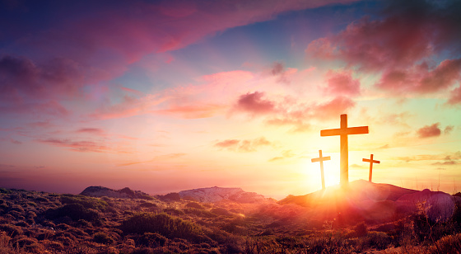
Thank You
For joining us
Please join us again Tuesday at 5PM

