Slide 1
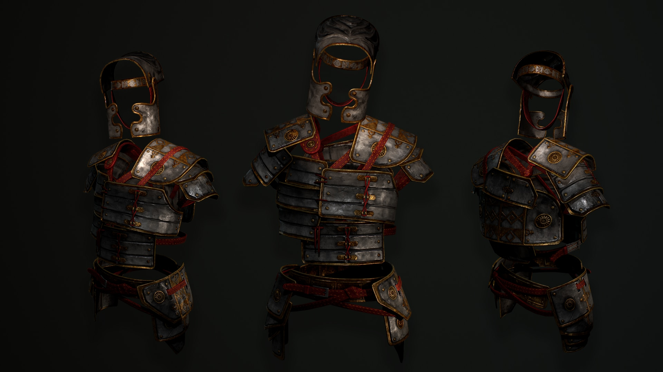
A BATTLE FOR THE
CHRISTIAN HOME
- The Sword of the Spirit -

Slide 2
THE POWER
OF THE SWORD

Slide 3
THE POWER OF THE SWORD
The Sword Of The Spirit

Slide 4
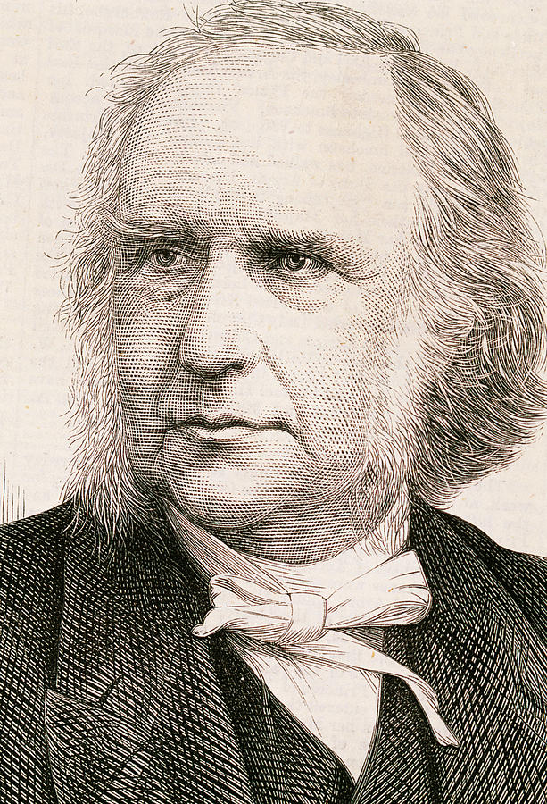
“The Bible is an armory of heavenly weapons, a laboratory of infallible medicines, a mine of exhaustless wealth. It is a guidebook for every road, a chart for every sea, a medicine for every malady, and a balm for every wound. Rob us of our Bible and our sky has lost its sun.”
Dr. Thomas Guthrie
1803 - 1873

Slide 5
THE PRECISION
OF THE SWORD

Slide 6
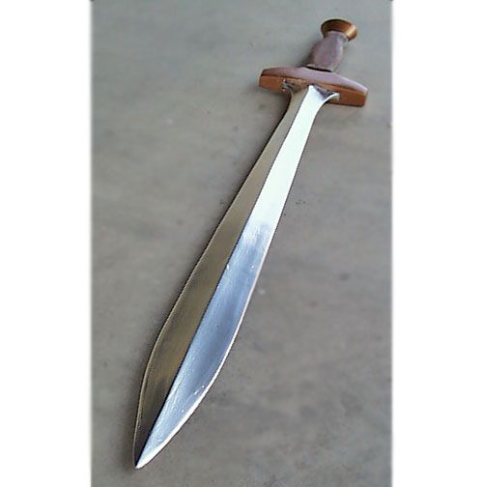
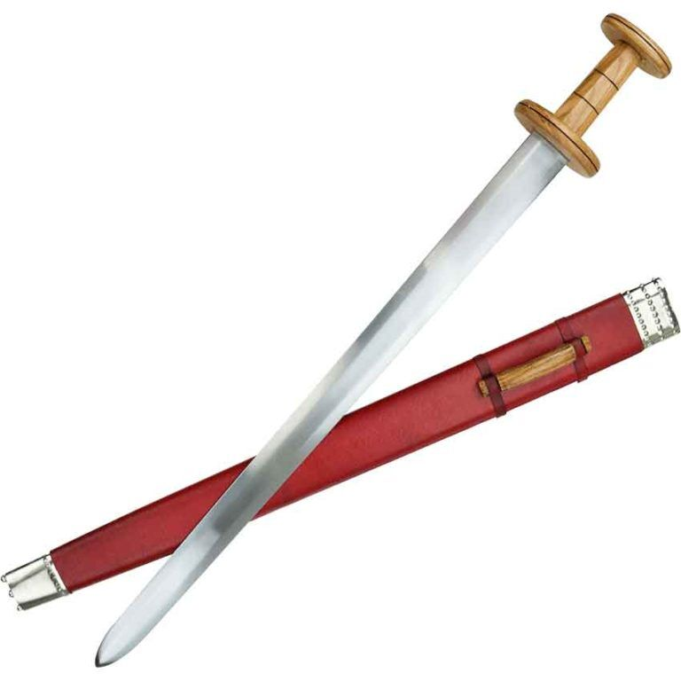
The Machaira – Short Sword
The Raphia – Long Sword

Slide 7
THE PREPARATION
OF THE SWORD

Slide 8
Five Places the Bible Should Be
1. It should be in your Hand.
2. It should be in your Head.
3. It should be in your Heart.
4. It should be in your Home.
5. It should be in your Habit.

Slide 9
A BATTLE FOR THE
CHRISTIAN HOME

