Slide 1
THREE TRUTHS FROM
THE LORD’S TABLE

Slide 2
OUR REJECTION OF IDOLATRY

Slide 3
OUR REJECTION OF IDOLATRY
A Description of Idolatry

Slide 4
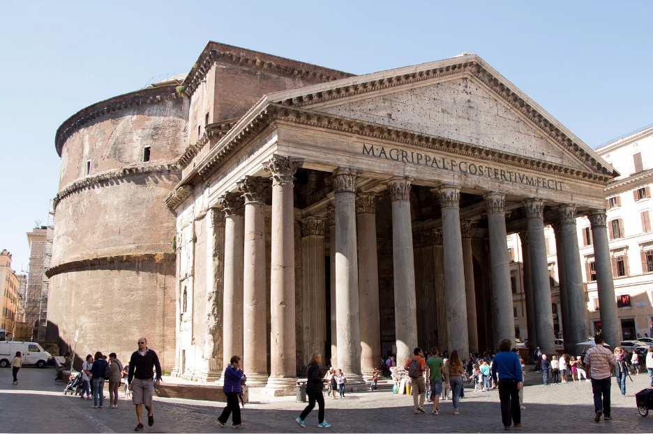

Slide 5
OUR REJECTION OF IDOLATRY
The Discernment with Idolatry

Slide 6
OUR RELATIONSHIP
TO THE LORD’S TABLE

Slide 7
OUR RELATIONSHIP TO THE LORD’S TABLE
The Meaning of Communion

Slide 8
OUR RELATIONSHIP TO THE LORD’S TABLE
The Identification of Communion

Slide 9
OUR REASONS FOR SEPERATION

Slide 10
OUR REASONS FOR SEPERATION
The Object of Our Worship Matters

Slide 11
OUR REASONS FOR SEPERATION
The Orientation of Our Worship Matters

Slide 12
THE LORD’S TABLE

