Slide 1

The Light of the World
Notes:
Jesus had just been in the temple, and while in the temple he declared his eternality, and the Pharisees took up stones – and so the Bible says that Jesus is now leaving the temple, or the area known as the temple mount.
And so their going to leave the place known as the Upper Room, and walk all the way to Gethsemane.
And as their walking to Gethsemane, their going to pass a place known as the Kidron Valley.

Slide 2
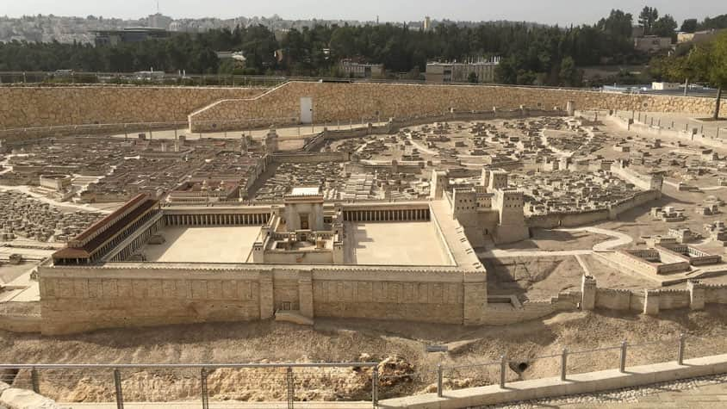
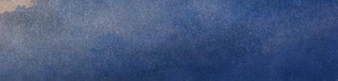
TEMPLE IN JERUSALEM
Notes:
And Jesus at this point, is going to send this man – after placing mud on his eyes – to the pool of Siloam, where he might wash and be cleaned and be healed.

Slide 3
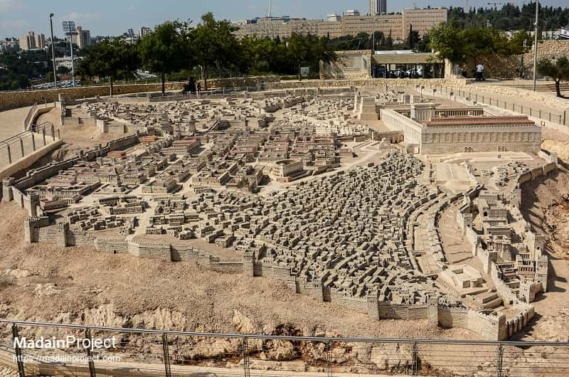
TEMPLE IN JERUSALEM
THE POOL OF SILOAM

Slide 4

THE MISSION
OF CHRIST

Slide 5
To Do The Father’s Will
Notes:
On October 8th, 1871, DL Moody preached a sermon to his congregation in which he gave them a full gospel presentation, unbridled, full of passion, encouraging all of them to make a decision for Christ.

Slide 6
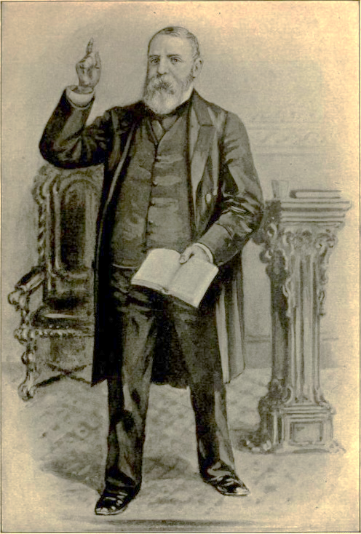
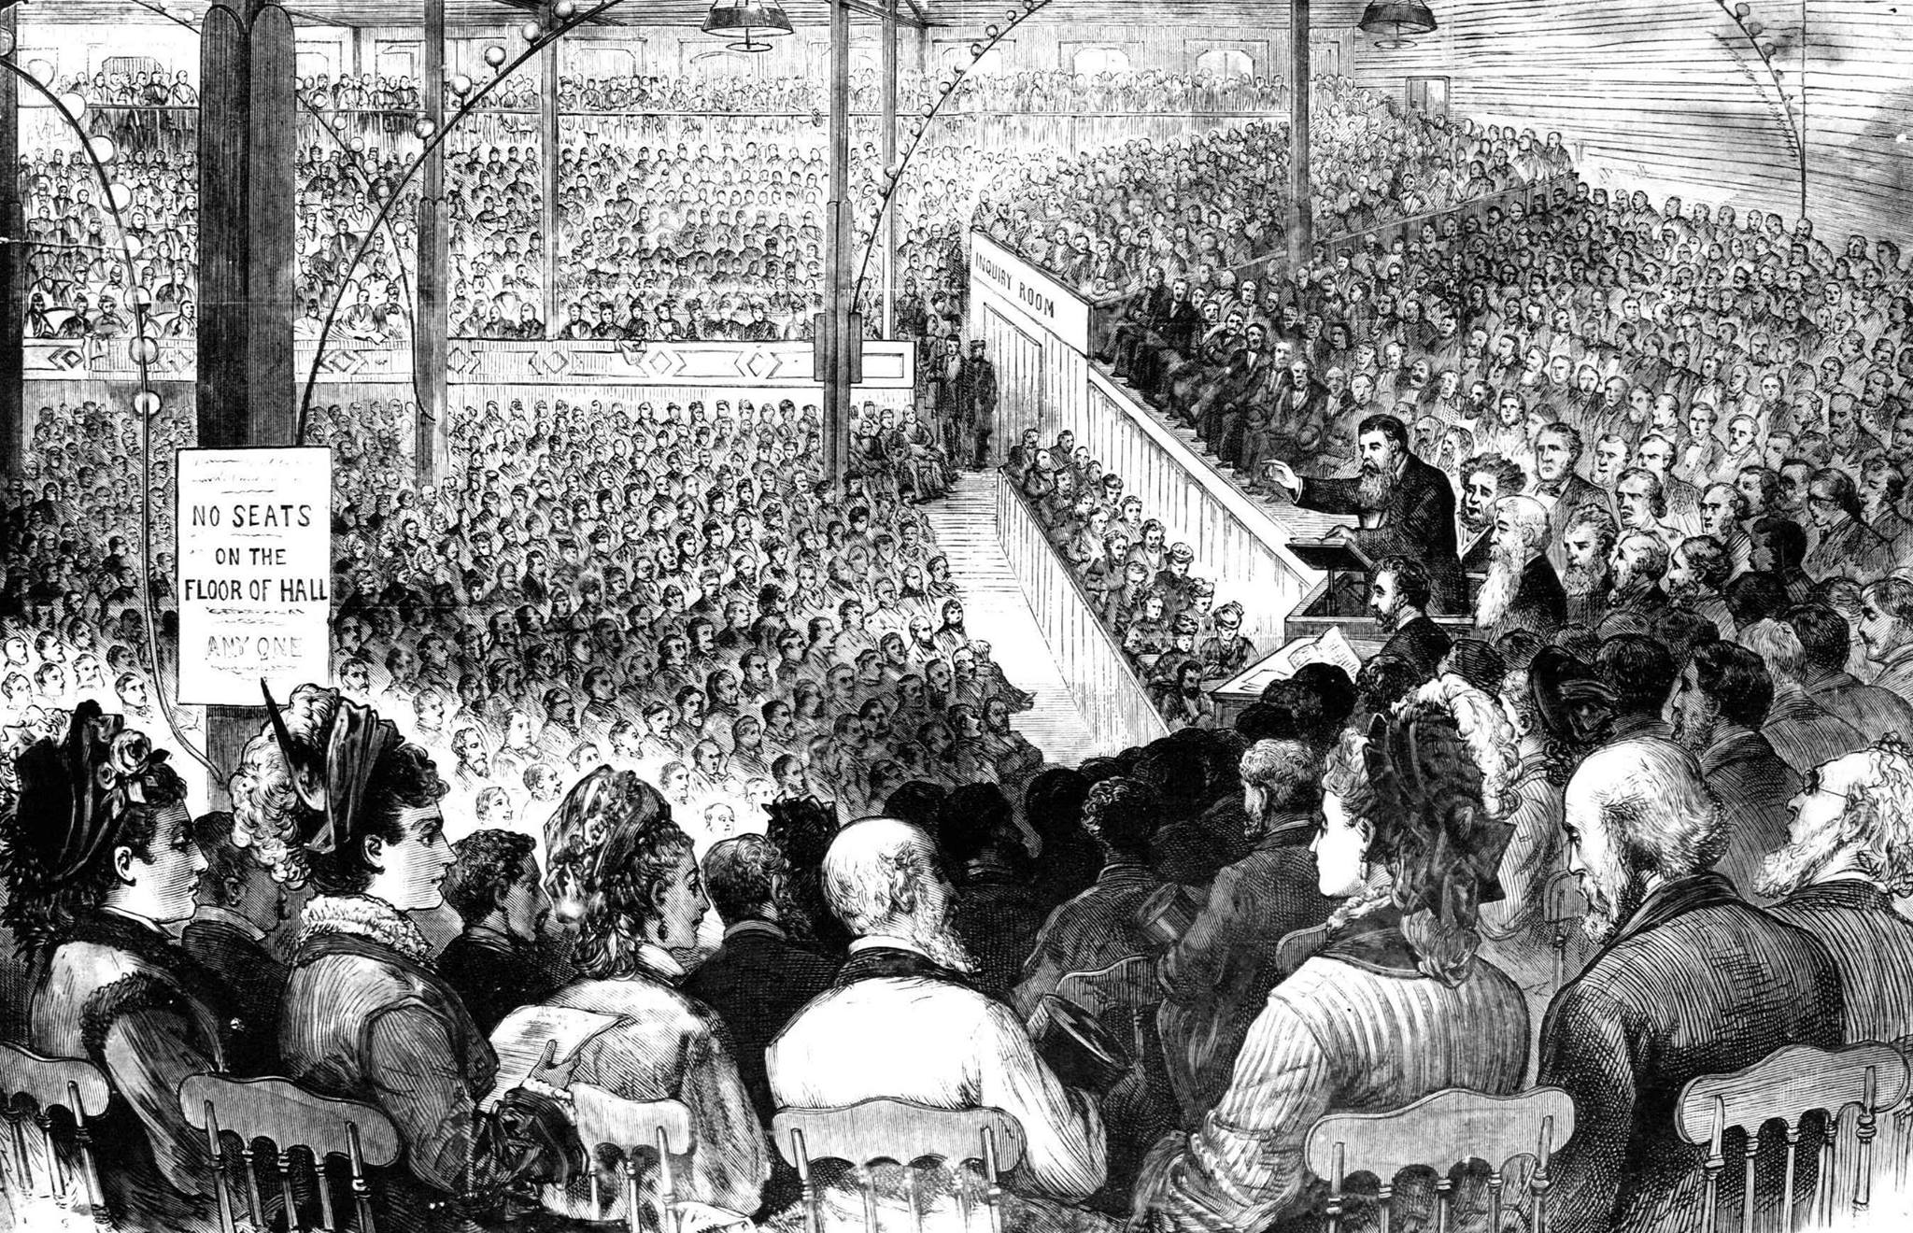

Slide 7
To Shine In A Fallen World

Slide 8
THE MANIFESTATION OF HIS LIGHT

Slide 9
In the Miraculous
Works of Christ

Slide 10
In the Message
of His People

Slide 11
THE MESSAGE OF THE PASSAGE

Slide 12
A Message of Revelation

Slide 13
A Message of Salvation

